Slide 1
Supervised learning
Xiaofeng Zhu

Slide 2
Outline
Regression
Logistic regression

Slide 3
Machine learning models
Supervised (inductive) learning
Training data includes desired outputs
Unsupervised learning
Training data does not include desired outputs
Semi-supervised learning
Training data includes a few desired outputs
Transfer learning
Training data includes a few outputs unrelated to training data

Slide 4


Machine Learning ≈ Looking for a Function
Speech Recognition
Image Recognition
“How are you”
“Cat”

Slide 5




Supervised learning
label
label₁
model/
predictor
label₃
label₄
label₅
Supervised learning: given labeled examples

Slide 6
Classification Techniques
Decision Tree based Methods
Rule-based Methods
Neural Networks
Naïve Bayes and Bayesian Belief Networks
Support Vector Machines
… …
Notes:
In machine learning, many techniques have been used to find the map between input and output, such as
Different methods have different methods to obtain the map, but most of classification techniques are similar for predicting the unseen data with the learnt map.

Slide 7
Machine learning framework
Y = f(x)
Training: given a training set of labeled examples {(x₁,y₁), …, (x_{n},y_{n})}, estimate the prediction function or objective function or cost function f by minimizing the prediction error on the training set
Testing: apply f to a never before seen test example x and output the predicted value Y = f(x)
If Y is continuous value, the prediction process to obtain f(X) is called regression. If Y is discrete value, the prediction process to obtain f(X) is called classification.
Feature
output
objective function

Slide 8
Machine Learning is so simple ……
Step 1: define a set of function
Step 2: goodness of function
Step 3: pick the best function

Slide 9
Least square
Given is a bivariate dataset (x1, y1), …, (xn, yn), where x1, …, xn are nonrandom and Yi = α + βxi + Ui are random variables for i = 1, 2, . . ., n. The random variables U1, U2, …, Un have zero expectation and variance σ ²
Method of Least Squares: Choose a value for α and β such that
S(α,β)=( ) is minimal.

Slide 10
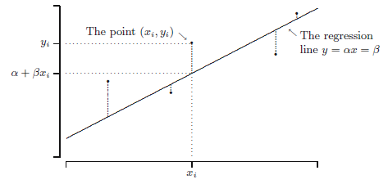
Least square
The observed value y_{i} corresponding to x_{i} and the value α+βx_{i} on the
regression line y = α + βx.

Slide 11
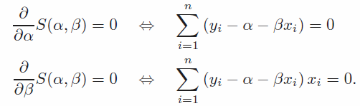
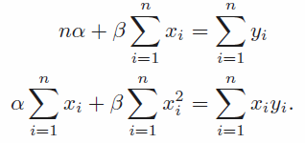
Estimation
Method of Least Squares: Choose a value for α and β such that
S(α,β)=( ) is minimal.
To find the least squares estimates, we differentiate S(α, β) with respect to α and β, and we set the derivatives equal to 0:
After some calculus magic, we get two equations to estimate α and β:

Slide 12
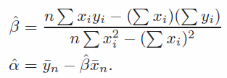
Estimation
After some simple algebraic rearranging, we obtain:
(slope)
(intercept)

Slide 13
Define a linear function
Simplest equation that describes the dependence of variable or output y on input X
is the slope vector

Slide 14
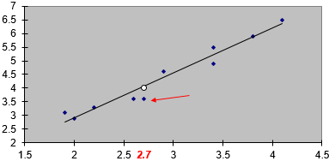
Searching a least squares prediction line to pass all points

Slide 15
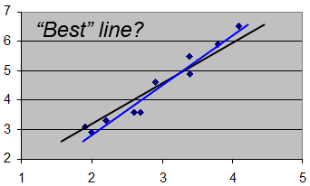
Goodness of functions

Slide 16
Pick the best function
How to get that can minimize the sum of squares of errors?
Gradient descent & convex optimization

Slide 17

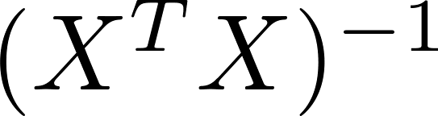
Pick the best function
n training examples, m features
Gradient descent
Convex optimization
Need to choose .
Needs many iterations.
No need to choose .
Don’t need to iterate.
Need to compute
Slow if m is very large.
Works well even when m is large.

Slide 18
Outline
Regression
Logistic regression

Slide 19
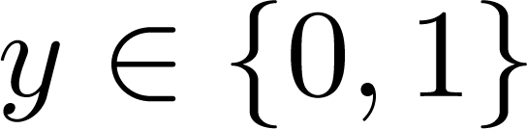
Logistic regression
Email: Spam / Not Spam?
Online Transactions: Fraudulent (Yes / No)?
Tumor: Malignant / Benign ?
0: “Negative Class” (e.g., benign tumor)
1: “Positive Class” (e.g., malignant tumor)
Threshold classifier output at 0.5:
If f(x) is larger than 0.5 , predict “y = 1”
If f(x) is not larger than 0.5 , predict “y = 0”

